Slide 1



Slide 2

Numero di turisti nel Mondo:
2012 – 1.000.000.000
2030 – 1.800.000.000

Slide 3
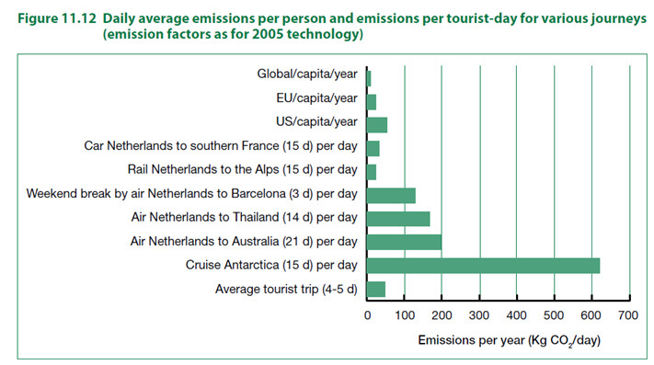

Slide 4
Nel 2011 solo il 45% dei turisti pensava che il turismo potesse avere
impatti negativi sull’ambiente.
Nel 2014 sono aumentati fino al 49%.
Temono:
Cementificazione (63%)
Inquinamento (15%)
Iper-sfruttamento delle risorse (20%)

Slide 5
… ma l’impronta ecologica dell’attività ricettiva può essere ridotta del 90% adottando buone pratiche.

Slide 6
“Business travelers understand the issues and are trying to do their part in being more environmentally responsible when they are on the road”
Adam Weissemberg - Deloitte Tourism, Hospitality and Leisure

Slide 7
93% of Conde Nast Traveler
readers surveyed in 2011
said that travel companies should be
responsible for protecting
the environment.

Slide 8
Since 2010, half of the world population has been living in cities, for the first time in human history.

Slide 9
71% di oltre 700 turisti USA dichiara che farà
vacanze eco-friendly nei prossimi 12 mesi.
57% dichiara di prendere spesso decisioni
di vacanza eco-friendly.
… ma il 44% ammette di essere più “ecologico”
a casa che in viaggio.

Slide 10
Il turismo responsabile è cresciuto
del 9% annuo in termini di presenze
e del 20% in termini di spesa turistica.

Slide 11
“Travelers are interested in eco-friendly practices, but hungry for more information about which green plans and policies are actually in place”
Jenny Rushmore – Director of responsible travel for Trip Advisor.

Slide 12
In the United States tourists pay $14.5 billion per year to visit the national parks.

Slide 14
60% dei turisti italiani sceglie mete dedicate alla natura.
65% sceglie tenendo in considerazione l’impatto che il proprio viaggio può avere sull’ambiente.

Slide 15
Riconoscono come vantaggiosi per l’ambiente:
Pannelli fotovoltaici (51%)
Menu biologici (29%)
Prodotti a chilometri zero (29%)
Risparmio idrico (27%)

Slide 16
Reduce costs and improve efficiencies.
-10% in energy use
= $ 750 mln/year
Gain competitive advantage by offering differentiating experiences to customers.
The Willard Intercontinental Hotel in Washington, DC
has documented over $ 1 million in new business a year
as a direct result of its sustainability initiatives

Slide 17
Manage risks and meet emerging legal and
regulatory requirements.
Meet emerging consumer trends.
Protect your business, by protecting
the environment on which it depends.
Tourism provides locals with incentives to
preserve the destination
in order to make it attractive to tourists

Slide 18
Ecotourism can return as much as 95% of revenues to the local economy, compared to only about 20% for “standard all-inclusive package tours” according to a 2011 UN-supported study.

Slide 19

Thank you for listening

